Slide 1
ETHERNET
Prepared by
Divya K S
Adi Shankara Institute of Engineering & Technology
Kalady

Slide 2
Ethernet
Ethernet cabling
Manchester encoding
Ethernet MAC sublayer protocol( Ethernet Frame format)
Binary Exponential Backoff algorithm.

Slide 3
ETHERNET
Ethernet is a way of connecting computers together in a local area network or LAN.
It has been the most widely used method of linking computers together in LANS since the 1990s.
The basic idea of its design is that multiple computers have access to it and can send data at any time.
describing how networked devices can format data for transmission to other network devices on the same network segment, and how to put that data out on the network connection.

Slide 4
ETHERNET
Ethernet is a network protocol that controls how data is transmitted over a LAN.
Technically it is referred to as the IEEE 802.3 protocol.

Slide 5
Advantages of Ethernet over other
technologies:
It is easy to understand, implement,manage, and maintain.
It allows low-cost network implementations.
It provides extensive topologicalflexibility for network installation.

Slide 6
ETHERNET CABLING
Four types of cabling are commonly used in Ethernet.
10Base5
10 Base 2
10 Base – T
10Base - F

Slide 7
ETHERNET CABLING-10Base5
Thick Ethernet.
Up to 100 stations can be connected to the cable using vampire taps (bus)
The system is difficult to install and maintain.

Slide 8
10 base 5
The 10 refers to its transmission speed of 10 Mbit/s. The BASE is short for baseband signaling as opposed to broadband,
The 5 stands for the maximum segment length of 500 meters (1,600 ft.).
It was the first Ethernet specification to use a bus topology with a external transceiver connected via a tap to a thick coaxial cable.
Advantages: Low attenuation, excellent noise
immunity, superior mechanical strength
Disadvantages: Bulky, difficult to pull, transceiver
boxes too expensive

Slide 9
10 Base 2
10BASE2 (also known as cheapernet, thin Ethernet, thinnet, and thinwire) is a variant of Ethernet that uses thin coaxial cable, terminated with BNC connectors
10BASE2 coax cables have a maximum length of 185 metres (607 ft).
The maximum practical number of nodes that can be connected to a 10BASE2 segment is limited to 30 with a minimum distance of 50 cm.
Advantages: Easier to install, reduced hardware
cost, BNC connectors widely deployed 🡺 lower
installation costs.
Disadvantages: Attenuation not as good, could
not support as many stations due to signal
reflection caused by BNC Tee Connector.

Slide 10
10 Base - T
Cables look like thick phone cables, but with 8 copper wires instead of 2 or 4, and they go from each computer' to a Hub or a Switch.
Supported speed is 10 MBit/second.
It uses star topology and the station are connected via two pairs of twisted cable(one for sending another for receiving) between the station and the hub.
The maximum length of the twisted cable here is defined as 100m,to minimize the effect of attenuation in the twisted cable.
Advantages: could be done without pulling new wires.
Each hub amplifies and restores incoming signal.

Slide 11
10Base - F
Same as 10Base-T, but cables transmit light pulses, instead of electrical signals
Using star topology.
Expensive due to the cost of the connectors and terminators.

Slide 12
MANCHESTER ENCODING
Manchester coding is a very common data coding method, probably the most common used today.
With Manchester coding, we can encode both clock and signal into one, and transmit the signal serially.
Manchester encoding is also widely used in infrared data transmissions, like for example the Phillips RC protocol.

Slide 13
MANCHESTER ENCODING
Here data are represented by logic 1 or 0, but with line transitions.
A logic LOW (0) is represented by a transition from HIGH to LOW.
And a logic HIGH (1) is represented by a transition from LOW to HIGH.

Slide 14
Differential Manchester encoding.
Variation of Manchester encoding.
Bit 1 is indicated by absence of transition at the start of interval
Bit 0 is indicated by presence of transition at the start of interval.

Slide 15
THE ETHERNET MAC SUBLAYER PROTOCOL
In standard Ethernet, the MAC sublayer,governs the operation of the access method.
It also frames data received from the upper layer and passes them to the physical layer.
Acknowledgement must be implemented at the higher layers.

Slide 16
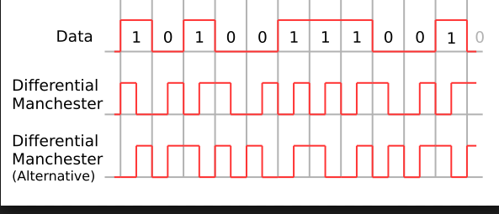

Slide 17
THE ETHERNET MAC SUBLAYER PROTOCOL
D The Ethernet frames contains seven fields: preamble,SFD,DA,SA,length or type of protocol data unit(PDU), upper-layer data, the Checksum.
Ethernet does not provide any mechanism for acknowledging received frames, making it what is known as an unreliable medium

Slide 18
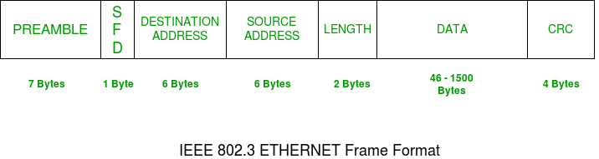
ETHERNET FRAME FORMAT
.

Slide 19
ETHERNET FRAME FORMAT
Preamble
consists of seven bytes all of the form 10101010.
this informs the receiving stations that a frame is starting as well as enabling synchronisation.
The Start frame delimiter is a single byte, 10101011, which is a frame flag, indicating the start of a frame.

Slide 20
ETHERNET FRAME FORMAT
Destination Address (DA) -
This field contains the address of station for which
the data is intended
Source Address (SA) -
The source address consists of six bytes, and it is used
to identify the sending station

Slide 21
ETHERNET FRAME FORMAT
Length – Length is a 2-Byte field, which indicates the length of entire Ethernet frame.
Data – This is the place where actual data is inserted,also known as Payload.
If the length of the field is less than 46 bytes, then padding data is added to bring its length up to the required minimum of 46 bytes.
Checksum – contains a 32-bit Cyclic Redundancy Check (CRC) which allows detection of corrupted data.

Slide 22
BINARY EXPONENTIAL BACK OFF ALGORITHM
Back-off algorithm is a collision resolution mechanism which is used in random access MAC protocols (CSMA/CD).
This algorithm is generally used in Ethernet to schedule re-transmissions after collisions.
If a collision takes place between 2 stations, they may restart transmission as soon as they can after the collision
. This will always lead to another collision and form an infinite loop of collisions leading to a deadlock.
To prevent such scenario back-off algorithm is used.

Slide 23
BACK OFF ALGORITHM
After a collision, time is divided into discrete slots (T_{slot}) whose length is equal to 2t, where t is the maximum propagation delay in the network.
The stations involved in the collision randomly pick an integer from the set K i.e {0, 1}.
This set is called the contention window.

Slide 24
BACK OFF ALGORITHM
If the sources collide again because they picked the same integer, the contention window size is doubled and it becomes {0, 1, 2, 3}.
Now the sources involved in the second collision randomly pick an integer from the set {0, 1, 2, 3} and wait that number of time slots before trying again.
Before they try to transmit, they listen to the channel and transmit only if the channel is idle.

Slide 25
BACK OFF ALGORITHM
This causes the source which picked the smallest integer in the contention window to succeed in transmitting its frame.
In general After nth collision ,randomly choose 1 slot in next 2^n
Back off is called exponential because the range from which the back off value is chosen is doubled after every successive collision involving the same packet

Slide 26
BACK OFF ALGORITHM
Back-off algorithm defines a waiting time for the stations involved in collision, i.e. for how much time the station should wait to re-transmit.
Waiting time = back–off time
Let n = collision number or re-transmission serial number.
Then,
Waiting time = K * T_{slot}
where K = [0, 2^{n} – 1 ]

Slide 27
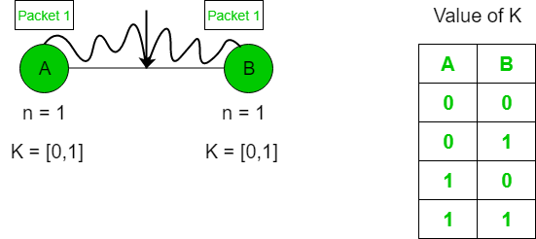
BACK OFF ALGORITHM EXAMPLE
Suppose 2 stations A and B start transmitting data (Packet 1) at the same time then, collision occurs. So, the collision number n for both their data (Packet 1) = 1. Now, both the station randomly pick an integer from the set K i.e. {0, 1}.

Slide 28
BACK OFF ALGORITHM EXAMPLE
When both A and B choose K = 0 –> Waiting time for A = 0 * T_{slot} = 0 Waiting time for B = 0 * T_{slot} = 0 Therefore, both stations will transmit at the same time and hence collision occurs.
When A chooses K = 0 and B chooses K = 1 –> Waiting time for A = 0 * T_{slot} = 0 Waiting time for B = 1 * T_{slot} = T_{slot} Therefore, A transmits the packet and B waits for time T_{slot} for transmitting and hence A wins.
When A chooses K = 1 and B chooses K = 0 –> Waiting time for A = 1 * T_{slot} = T_{slot} Waiting time for B = 0 * T_{slot} = 0
Therefore, B transmits the packet and A waits for time T_{slot} for transmitting and hence B wins.

Slide 29
BACK OFF ALGORITHM EXAMPLE
When both A and B choose K = 1 –> Waiting time for A = 1 * T_{slot} = T_{slot} Waiting time for B = 1 * T_{slot} = T_{slot} Therefore, both will wait for the same time T_{slot} and then transmit. Hence, collision occurs.
Probability that A wins = 1/4
Probability that B wins = 1/4
Probability of collision = 2/4

Slide 30
BACK OFF ALGORITHM
Advantage –
Collision probability decreases exponentially.
Disadvantages –
Capture effect: Station who wins ones keeps on winning.
Works only for 2 stations or hosts.

Slide 31


